Slide 1
Principles of Scientific Computing

Slide 2

Intro to Your Instructors
I am Tobin Wainer, a graduate student working on getting my PhD at UW in Astronomy
In my spare time, I am a big sports fan, and enjoy hiking/skiing/climbing
You can reach me at tobinw@uw.edu

Slide 3
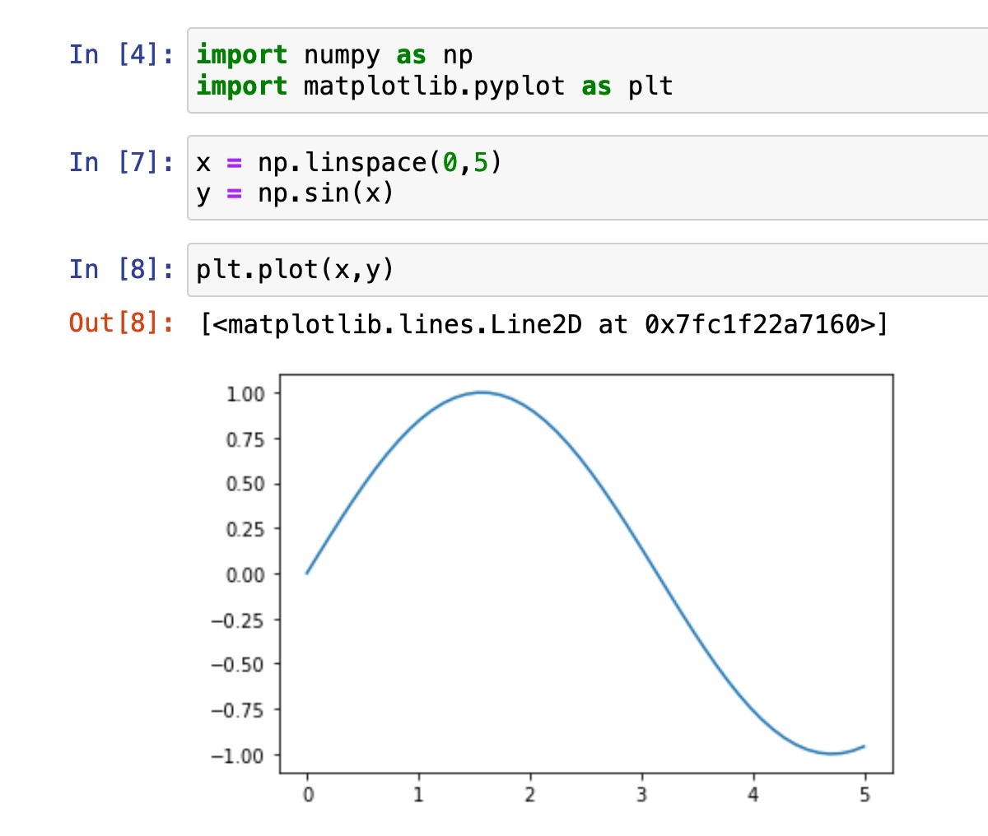
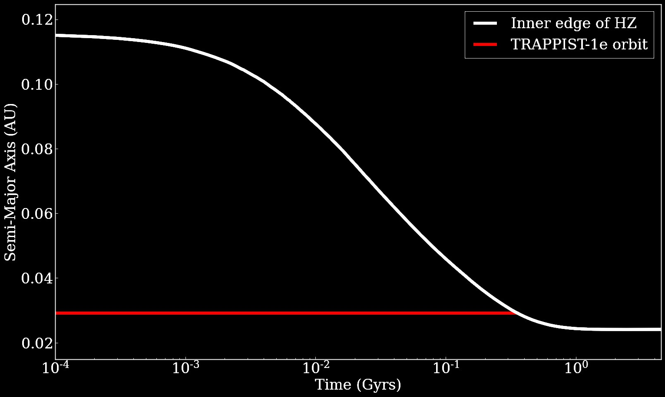
This class is about learning the computational tools that scientists use

Slide 4
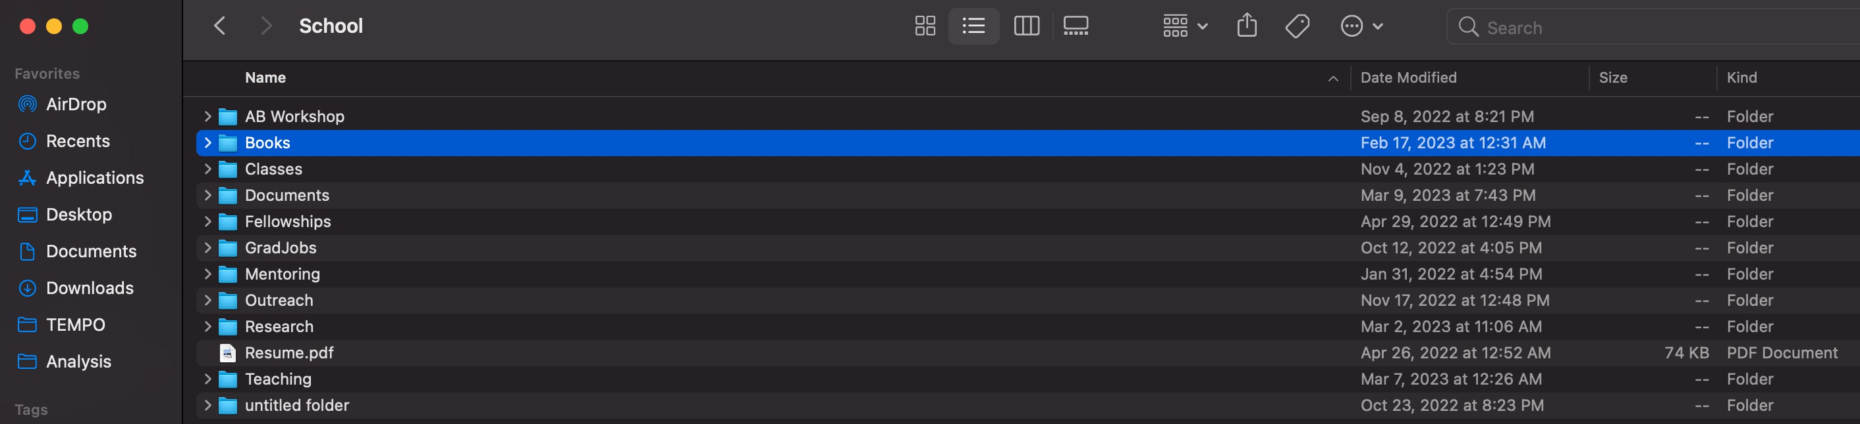
Scientists and engineers interact with computers in a different way than you might be used to
Instead of

Slide 5
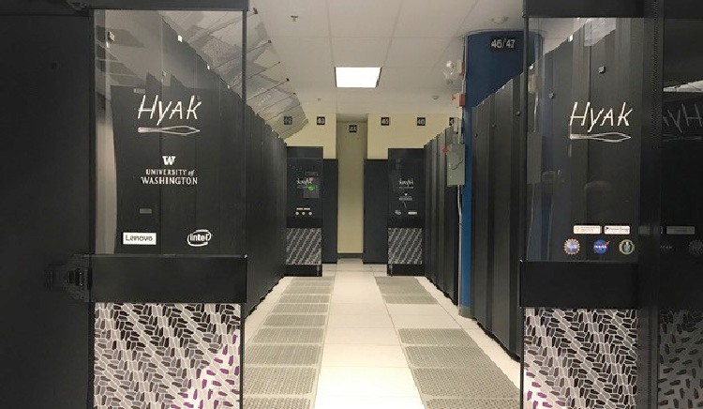
Scientists and engineers interact with computers in a different way than you might be used to

Slide 6
Workshop Expectations - Format
Most of the time, this class will be both in this classroom and on Zoom at: https://washington.zoom.us/j/97785225933
I will not physically be here, but Zach will
Normally in class, I will walk y’all through a notebook to learn aspects of programming that are related to working with data

Slide 7
Workshop Expectations - Homework
I am fully aware that this is not a class, and therefore there will be no formal homework; however, each meeting we will be going through a notebook together which we will not finish in class. It will be your responsibility to finish the notebooks if you would like the extra practice. If you would like feedback on your notebooks, please send it to me over email, and I’m happy to give feedback.

Slide 8
Today’s Schedule and Goals
Download all the necessary software and get our computers ready for the class
Make sure to check in with us as you’re downloading the software, so that we know you’ve got it all done
Introduction to the first “homework”

Slide 9
Today’s Schedule and Goals
For those of you with Windows PCs
Download and install Windows Subsystem for Linux
Set up user profile on WSL
Download and install anaconda on the WSL
Install jupyter with conda
Check to make sure jupyter notebook is working
For those of you with Macbooks
Download and install anaconda
Install jupyter with conda in your Terminal
Check to make sure jupyter notebook is working

Slide 10
Steps for Installing WSL
Open the application PowerShell by right-clicking on it and selecting “run as administrator”
In the PowerShell, type “wsl —install” (do not include the quotation marks)
When it’s done, reboot the computer, the prompt should open up, if it doesn’t, search for an app called “Ubuntu” and open it
Go through the process and type a username and password, do not include spaces in either of these. Note, when you type the password, you won't see anything

Slide 11
Steps for Installing Anaconda
Install Anaconda in your command line
For Windows: wget https://repo.anaconda.com/archive/Anaconda3-2024.02-1-Linux-x86_64.sh
For Mac: go to https://repo.anaconda.com/archive and download Anaconda3-2024.02-1-MacOSX-x86_64.sh
NOTE (if you have an M1 chip in your Macbook, you will need to download Anaconda3-2024.02-1-MacOSX-arm64.sh)
Run the installer
For Windows, in Ubuntu type: bash Anaconda3-2024.02-1-Linux-x86_64.sh
For Mac, open up Terminal and type: bash Anaconda3-2024.02-1-MacOSX-x86_64.sh
Make sure to hit the “enter” key when it prompts you on where it should install the directory
Make sure to type “yes” when it asks if you’d like to initialize Anaconda
When Anaconda is done, close your Terminal, and then re-open it

Slide 12
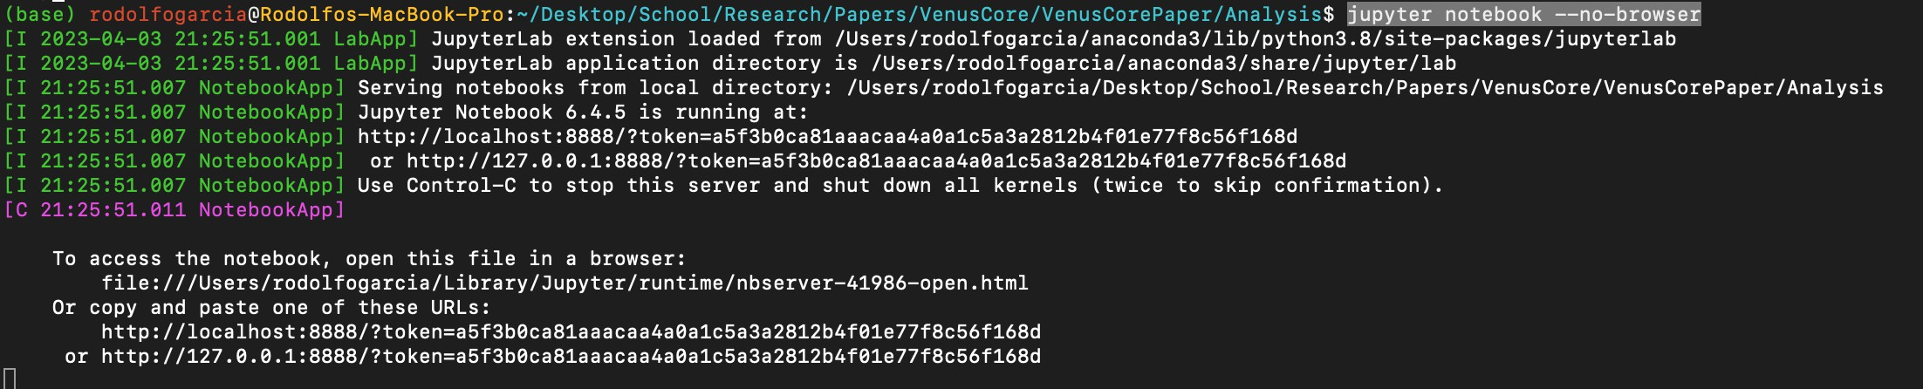
Steps for Installing Jupyter
Open your Terminal (the app is called Terminal for Mac users, it’s called Ubuntu for Windows users)
Once anaconda is installed, type “conda install jupyter” in your Terminal
Once successfully installed, type “jupyter notebook —no-browser” into your Terminal, you should see an output that looks like this
Copy and paste one of the URLs into a web browser
Jupyter is sucessfully installed! You can now close that window in your web browser, and you can close Terminal by pressing “ctrl+c” and entering “yes”.

Slide 13
Getting Started
Content from this workshop will be disseminated through github:
Here is the link to the github:
https://github.com/tobin-wainer/YVCC_Computing_2025/tree/main
From the command line: git clone https://github.com/tobin-wainer/YVCC_Computing_2025.git

